Slide 1


Group 11 Midterm
Members: Thomas Herold, John Klein, & Logan Oslund

Slide 2
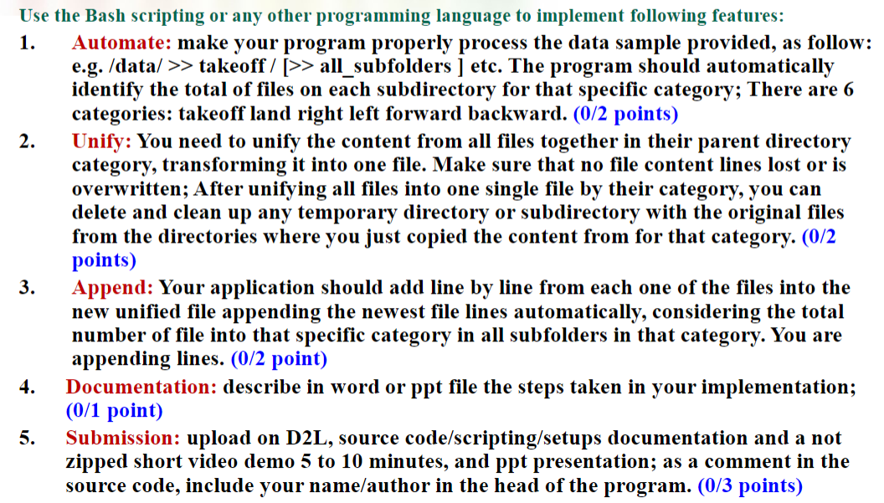
Objectives

Slide 3

Language of Choice

Slide 4
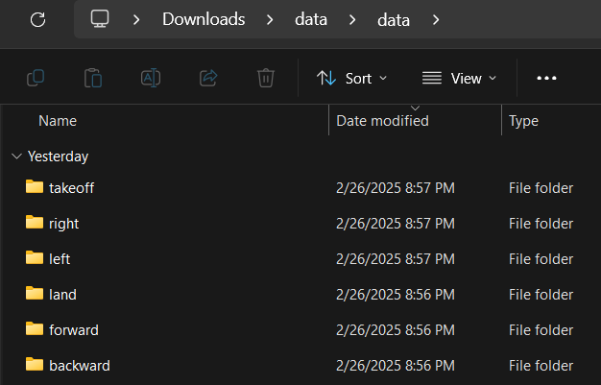
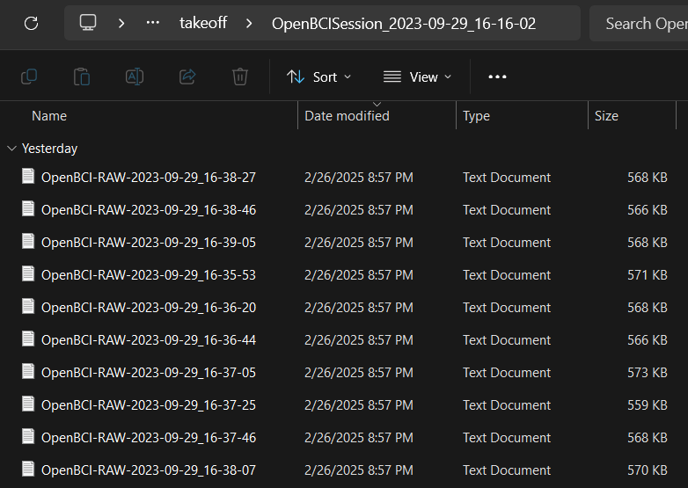
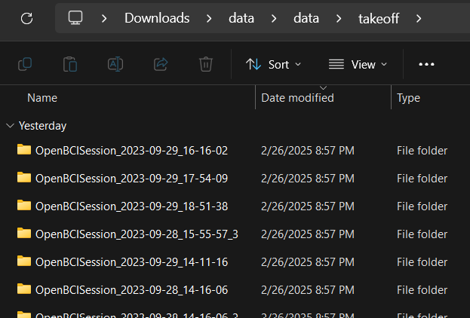
Data - Input
6 Categories
~10 Data files per subfolder
~30 Subdirectories per Category

Slide 5
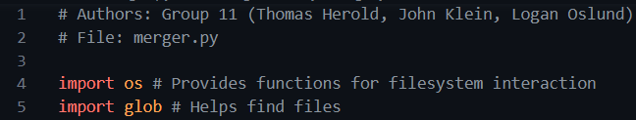

Code – importing and program start

Slide 6
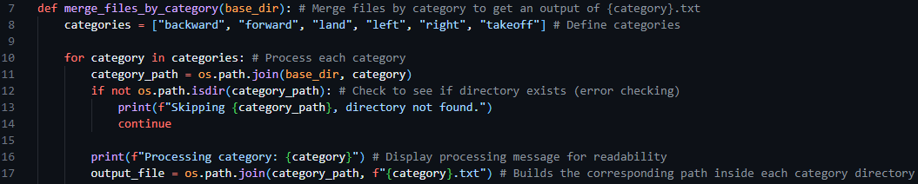
Code - merge_files_by_category

Slide 7
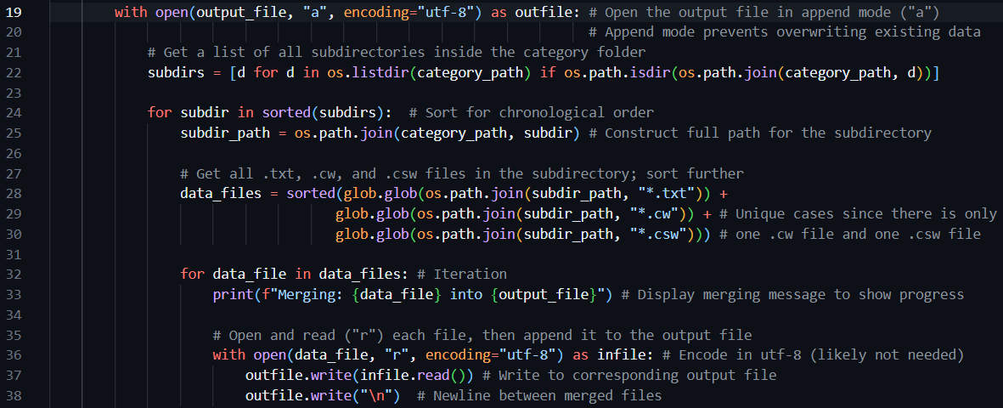
Code – inside merge_files_by_category

Slide 8
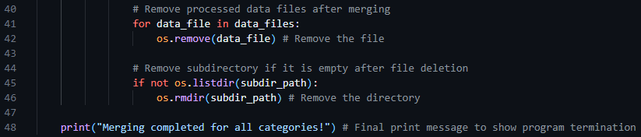
Code – inside merge_files_by_category

Slide 9
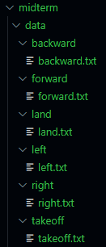
Data - Output

Slide 10
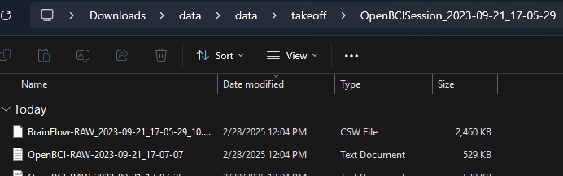
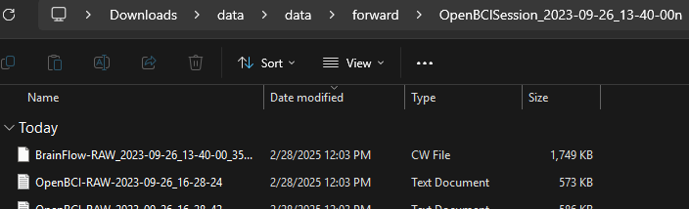
Troubleshooting

